Slide 1
Chapter 7
Using Indicator and
Interaction Variables
Terry Dielman
Applied Regression Analysis:
A Second Course in Business and Economic Statistics, fourth edition
Indicator Variables
Copyright © 2005 Brooks/Cole, a division of Thomson Learning, Inc.

Slide 2
7.1 Using and Interpreting Indicator Variables
Suppose some observations have a particular characteristic or attribute, while others do not.
We can include this information in the regression model by using dummy or indicator variables.
Indicator Variables
Copyright © 2005 Brooks/Cole, a division of Thomson Learning, Inc.

Slide 3
Add the info thru a coding scheme
Use a binary (dummy) variable to “indicate” when the characteristic is present
D_{i} = 1 if observation i has the attribute
D_{i} = 0 if observation i does not have it
Indicator Variables
Copyright © 2005 Brooks/Cole, a division of Thomson Learning, Inc.

Slide 4
An Example
D_{i} = 1 if individual i is employed
D_{i} = 0 if individual i is not employed
We could do it the other way and use the "1" to indicate an unemployed individual.
Indicator Variables
Copyright © 2005 Brooks/Cole, a division of Thomson Learning, Inc.

Slide 5
Multiple Categories
For multiple categories, use multiple indicators.
For example, to indicate where a firm's stock is listed, we could define 3 indicator variables; one each for the NYSE, AMEX and NASDAQ.
For computational reasons, we would include only two of these in the regression.
Indicator Variables
Copyright © 2005 Brooks/Cole, a division of Thomson Learning, Inc.

Slide 6
Example 7.1 Employment Discrimination
If two groups have apparently different salary structures, you first need to account for differences in education, training and experience before any claim of discrimination can be made.
Regression analysis with an indicator variable for the group is a way to investigate this.
Indicator Variables
Copyright © 2005 Brooks/Cole, a division of Thomson Learning, Inc.

Slide 7
Treasury Versus Harris
The data set HARRIS7 contains information on the salaries of 93 employees of the Harris Trust and Savings Bank. They were sued by the US Department of Treasury in 1981.
Here we examine how salary depends on education, also accounting for gender.
Indicator Variables
Copyright © 2005 Brooks/Cole, a division of Thomson Learning, Inc.

Slide 8
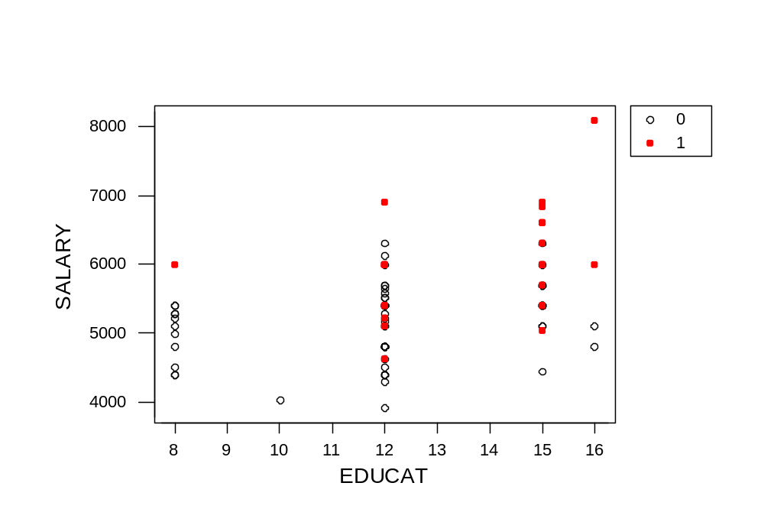
Salary Versus Years of Education
At all levels of education, the male salaries appear higher.
Indicator Variables
Copyright © 2005 Brooks/Cole, a division of Thomson Learning, Inc.

Slide 9
Regression Analysis
The regression equation is
SALARY = 4173 + 80.7 EDUCAT + 692 MALES
Predictor Coef SE Coef T P
Constant 4173.1 339.2 12.30 0.000
EDUCAT 80.70 27.67 2.92 0.004
MALES 691.8 132.2 5.23 0.000
S = 572.4 R-Sq = 36.3% R-Sq(adj) = 34.9%
How do we interpret this equation?
Indicator Variables
Copyright © 2005 Brooks/Cole, a division of Thomson Learning, Inc.

Slide 10
An Intercept Adjuster
For an indicator variable, the b_{j} is not really a slope. To see this, evaluate the equation for the two groups.
FEMALES (MALES = 0)
  SALARY = 4173 + 80.7 EDUCAT + 692 MALES
  = 4173 + 80.7 EDUCAT + 692 (0)
  = 4173 + 80.7 EDUCAT
MALES (MALES = 1)
  SALARY = 4173 + 80.7 EDUCAT + 692 MALES
  = 4173 + 80.7 EDUCAT + 692 (1)
  = 4173 + 80.7 EDUCAT + 692
  = 4865 + 80.7 EDUCAT
Indicator Variables
Copyright © 2005 Brooks/Cole, a division of Thomson Learning, Inc.

Slide 11
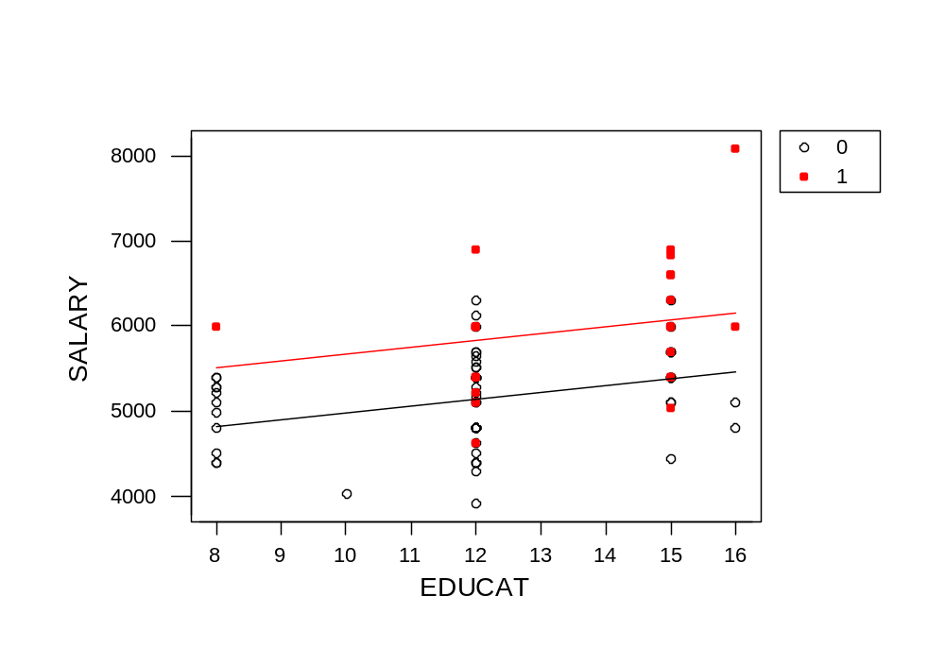
Parallel Salary Equations
Indicator Variables
Copyright © 2005 Brooks/Cole, a division of Thomson Learning, Inc.

Slide 12
Is The Difference Significant?
H₀: β_{MALES} = 0
H_{a}: β_{MALES} ≠ 0
Use t = b/SE_{b} as usual
t = 5.23 is significant
(After accounting for years of education, there is no salary difference)
(After accounting for education, there IS a salary difference)
Indicator Variables
Copyright © 2005 Brooks/Cole, a division of Thomson Learning, Inc.

Slide 13
What if the Coding Was Different?
If we had an indicator for females and used it, the equation would be:
SALARY = 4865 + 80.7 EDUCAT - 692 FEMALES
The difference between the groups is the same. For females, the intercept in the equation is 4865 – 692 = 4173
Indicator Variables
Copyright © 2005 Brooks/Cole, a division of Thomson Learning, Inc.

Slide 14
Multiple Categories
Pick one category as the "base category".
Create one indicator variable for each other category.
In general, if there are m categories, use m – 1 indicator variables.
Indicator Variables
Copyright © 2005 Brooks/Cole, a division of Thomson Learning, Inc.

Slide 15
Example 7.3 Meddicorp Sales
Y = Sales in one of 25 territories
X₁ = advertising in territory
X₂ = bonuses paid in territory
Also Region: 1 = South
2 = West
3 = Midwest
Indicator Variables
Copyright © 2005 Brooks/Cole, a division of Thomson Learning, Inc.

Slide 16
How do you use region?
What happens if you just put it in the model?
Sales = -84 + 1.55 ADV + 1.11 BONUS + 119 Region
R² = 92.0% and S_{e} = 68.89
SE(Region) = 28.69 so t_{stat} = 4.14 is significant
Indicator Variables
Copyright © 2005 Brooks/Cole, a division of Thomson Learning, Inc.

Slide 17
Region as an X
This implies the difference between Region 3 (MW) and Region 2 (W) = b₃ = 119
And the difference between Region 2 (W) and Region 1 (S) is also 119
The sales differences may not be equal but this forces them to be estimated that way
Indicator Variables
Copyright © 2005 Brooks/Cole, a division of Thomson Learning, Inc.

Slide 18
A more flexible approach
Use two indicator variables to tell the three regions apart
Can use any one of the three as the “base” category.
Here is what it looks like if Midwest is selected as the base.
Indicator Variables
Copyright © 2005 Brooks/Cole, a division of Thomson Learning, Inc.

Slide 19
Coding scheme
Region | D₁ South | D₂ West
SOUTH
WEST
MIDWEST
1
0
0
0
1
0
Indicator Variables
Copyright © 2005 Brooks/Cole, a division of Thomson Learning, Inc.

Slide 20
Results
SALES = 435 + 1.37ADV + .975 BONUS
- 258 South – 210 West
R² = 94.7 and S_{e} = 57.63
Both indicators are significant
Indicator Variables
Copyright © 2005 Brooks/Cole, a division of Thomson Learning, Inc.

Slide 21
This Defines Three Equations
SALES = 435 + 1.37ADV + .975 BONUS
- 258 South – 210 West
S: SALES = 177 + 1.37ADV + .975 BONUS
W: SALES = 225 + 1.37ADV + .975 BONUS
MW: SALES = 435 + 1.37ADV + .975 BONUS
Indicator Variables
Copyright © 2005 Brooks/Cole, a division of Thomson Learning, Inc.

Slide 22
Is Location Significant?
Because location is measured by two variables in a group, we need to do a partial F test.
The full Model has ADV, BONUS, SOUTH and WEST and has R² = 94.7
The reduced model has only ADV and BONUS, with R² = 85.5
Indicator Variables
Copyright © 2005 Brooks/Cole, a division of Thomson Learning, Inc.

Slide 23
Output For F-Test
FULL MODEL
S = 57.63 R-Sq = 94.7% R-Sq(adj) = 93.6%
Analysis of Variance
Source DF SS MS F P
Regression 4 1182560 295640 89.03 0.000
Residual Error 20 66414 3321
Total 24 1248974
REDUCED MODEL
S = 90.75 R-Sq = 85.5% R-Sq(adj) = 84.2%
Analysis of Variance
Source DF SS MS F P
Regression 2 1067797 533899 64.83 0.000
Residual Error 22 181176 8235
Total 24 1248974
Indicator Variables
Copyright © 2005 Brooks/Cole, a division of Thomson Learning, Inc.

Slide 24
Partial F Computations
(SSE_{R} – SSE_{F}) / (K – L)
F =
MSE_{F}
(181176 - 66414)/ (4-2)
= = 17.3
3321
Indicator Variables
Copyright © 2005 Brooks/Cole, a division of Thomson Learning, Inc.

Slide 25
7.2 Interaction Variables
Another type of variable used in regression models is an interaction variable.
This is usually formulated as the product of two variables; for example, x₃ = x₁x₂
With this variable in the model, it means the level of x₂ changes how x₁ affects Y
Indicator Variables
Copyright © 2005 Brooks/Cole, a division of Thomson Learning, Inc.

Slide 26
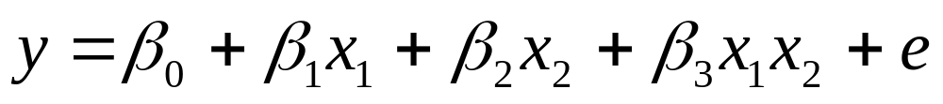
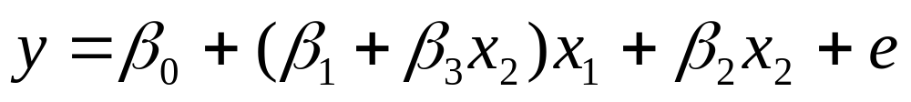
Interaction Model
With two x variables the model is:
If we factor out x₁ we get:
so each value of x₂ yields a different slope in the relationship between y and x₁
Indicator Variables
Copyright © 2005 Brooks/Cole, a division of Thomson Learning, Inc.

Slide 27
Sales on ADV & BONUS
(note) ADV*BONUS may be not significant
Indicator Variables
Copyright © 2005 Brooks/Cole, a division of Thomson Learning, Inc.

Slide 28

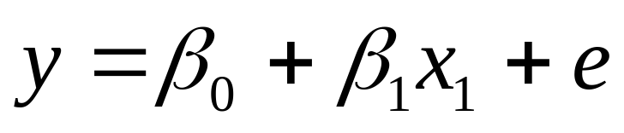
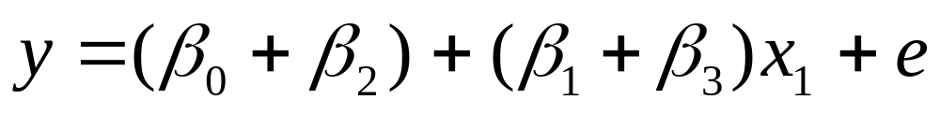
Interaction Involving an Indicator
If one of the two variables is binary, the interaction produces a model with two different slopes.
When x₂ = 0
When x₂ = 1
Indicator Variables
Copyright © 2005 Brooks/Cole, a division of Thomson Learning, Inc.

Slide 29
Example 7.4 Discrimination (again)
In the Harris Bank case, suppose we suspected that the salary difference by gender changed with different levels of education.
To investigate this, we created a new variable MSLOPE = EDUCAT*MALES and added it to the model.
Indicator Variables
Copyright © 2005 Brooks/Cole, a division of Thomson Learning, Inc.

Slide 30
Regression Output
The regression equation is
SALARY = 4395 + 62.1 EDUCAT - 275 MALES + 73.6 MSLOPE
Predictor Coef SE Coef T P
Constant 4395.3 389.2 11.29 0.000
EDUCAT 62.13 31.94 1.95 0.055
MALES -274.9 845.7 -0.32 0.746
MSLOPE 73.59 63.59 1.16 0.250
S = 571.4 R-Sq = 37.3% R-Sq(adj) = 35.2%
How do we interpret the equation this time?
Indicator Variables
Copyright © 2005 Brooks/Cole, a division of Thomson Learning, Inc.

Slide 31

Indicator Variables
Copyright © 2005 Brooks/Cole, a division of Thomson Learning, Inc.

Slide 32
A Slope Adjuster
To see the interaction effect, once again evaluate the equation for the two groups.
FEMALES (MALES = 0)
SALARY = 4395 + 62.1 EDUCAT - 275 MALES + 73.6 MSLOPE
= 4395 + 62.1 EDUCAT - 275 (0) + 73.6 (EDUCAT*0)
  = 4395 + 62.1 EDUCAT
MALES (MALES = 1)
SALARY = 4395 + 62.1 EDUCAT - 275 MALES + 73.6 MSLOPE
= 4395 + 62.1 EDUCAT - 275 (1) + 73.6 (EDUCAT*1)
  = 4395 + 62.1 EDUCAT – 275 + 73.6 EDUCAT
  = 4120 + 135.7 EDUCAT
Indicator Variables
Copyright © 2005 Brooks/Cole, a division of Thomson Learning, Inc.

Slide 33

Lines With Two Different Slopes
A bigger gap occurs at higher education levels
Indicator Variables
Copyright © 2005 Brooks/Cole, a division of Thomson Learning, Inc.

Slide 34

Tests in This Model
Although the slope adjuster implies the salary gap increases with education, this effect is not really significant (t_{MSLOPE} = 1.16).
The overall affect of gender is now contained in two variables, so a partial F test would be needed to test for differences between male and female salaries.
Indicator Variables
Copyright © 2005 Brooks/Cole, a division of Thomson Learning, Inc.

Slide 35
7.3 Seasonal Effects in Time Series Regression
Data collected over time (say quarterly)
If we think the Y variable depends on the calendar can do a kind of “seasonal adjustment” by adding quarter dummies
Q1 = 1 if this was first quarter, Q2 = 1 if a second quarter, Q3 = 1 if third
Don’t use Q4 since that is the “base”
Indicator Variables
Copyright © 2005 Brooks/Cole, a division of Thomson Learning, Inc.

Slide 36
Seasonal Adjustment
 | Q1 | Q2 | Q3
1st Quarter | 1 | 0 | 0
2nd Quarter | 0 | 1 | 0
3rd Quarter | 0 | 0 | 1
4th Quarter (BASE) | 0 | 0 | 0
Indicator Variables
Copyright © 2005 Brooks/Cole, a division of Thomson Learning, Inc.

Slide 37
Example 7.5 ABX Company Sales
We fit a trend to these sales in Example 3.11 by regressing sales on a time index variable.
Because this company sells winter sports merchandise, including seasonal effects should markedly improve the fit.
Indicator Variables
Copyright © 2005 Brooks/Cole, a division of Thomson Learning, Inc.

Slide 38
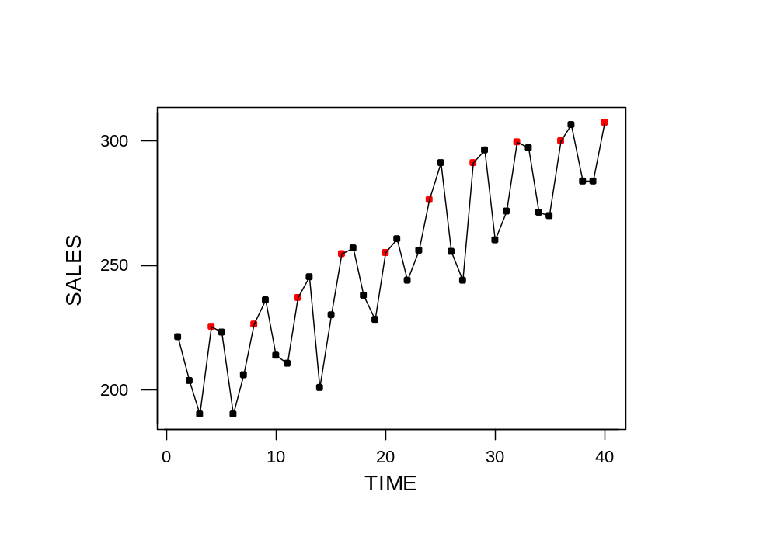
ABX Company Sales
4th qtr
Indicator Variables
Copyright © 2005 Brooks/Cole, a division of Thomson Learning, Inc.

Slide 39
Two Regressions
The regression equation is
SALES = 199 + 2.56 TIME
Predictor Coef SE Coef T P
Constant 199.017 5.128 38.81 0.000
TIME 2.5559 0.2180 11.73 0.000
S = 15.91 R-Sq = 78.3% R-Sq(adj) = 77.8%
The regression equation is
SALES = 211 + 2.57 TIME + 3.75 Q1 - 26.1 Q2 - 25.8 Q3
Predictor Coef SE Coef T P
Constant 210.846 3.148 66.98 0.000
TIME 2.56610 0.09895 25.93 0.000
Q1 3.748 3.229 1.16 0.254
Q2 -26.118 3.222 -8.11 0.000
Q3 -25.784 3.217 -8.01 0.000
S = 7.190 R-Sq = 95.9% R-Sq(adj) = 95.5%
Indicator Variables
Copyright © 2005 Brooks/Cole, a division of Thomson Learning, Inc.

Slide 40

Are the Seasonal Effects Significant?
The strong t-ratios for Q2 and Q3 say "yes" and the model R² increased by 17.6% when we added the seasonal indicators.
With evidence this strong we probably don't need to test further.
In general, however, we would need another partial F test to see if the overall seasonal effect is significant.
Indicator Variables
Copyright © 2005 Brooks/Cole, a division of Thomson Learning, Inc.

